Slide 1
ARTs lab meeting
Puja Chowdhury
Date: 15/2/22

Slide 2
Work
FFT FPGA implementation
Poster making for SPIE
Experiment 12 data sets

Slide 3
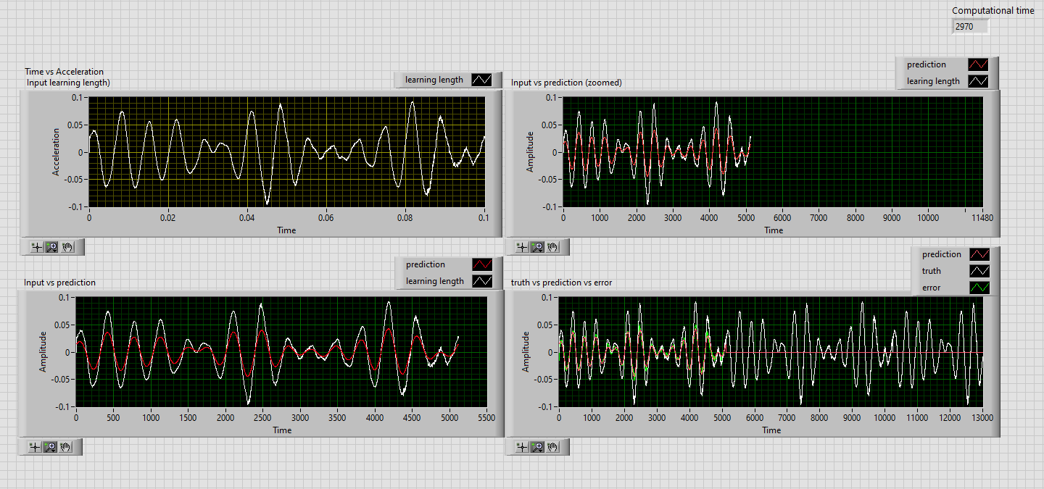
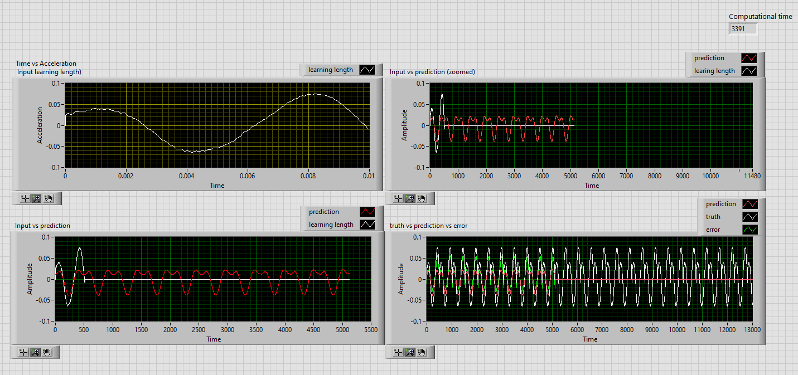
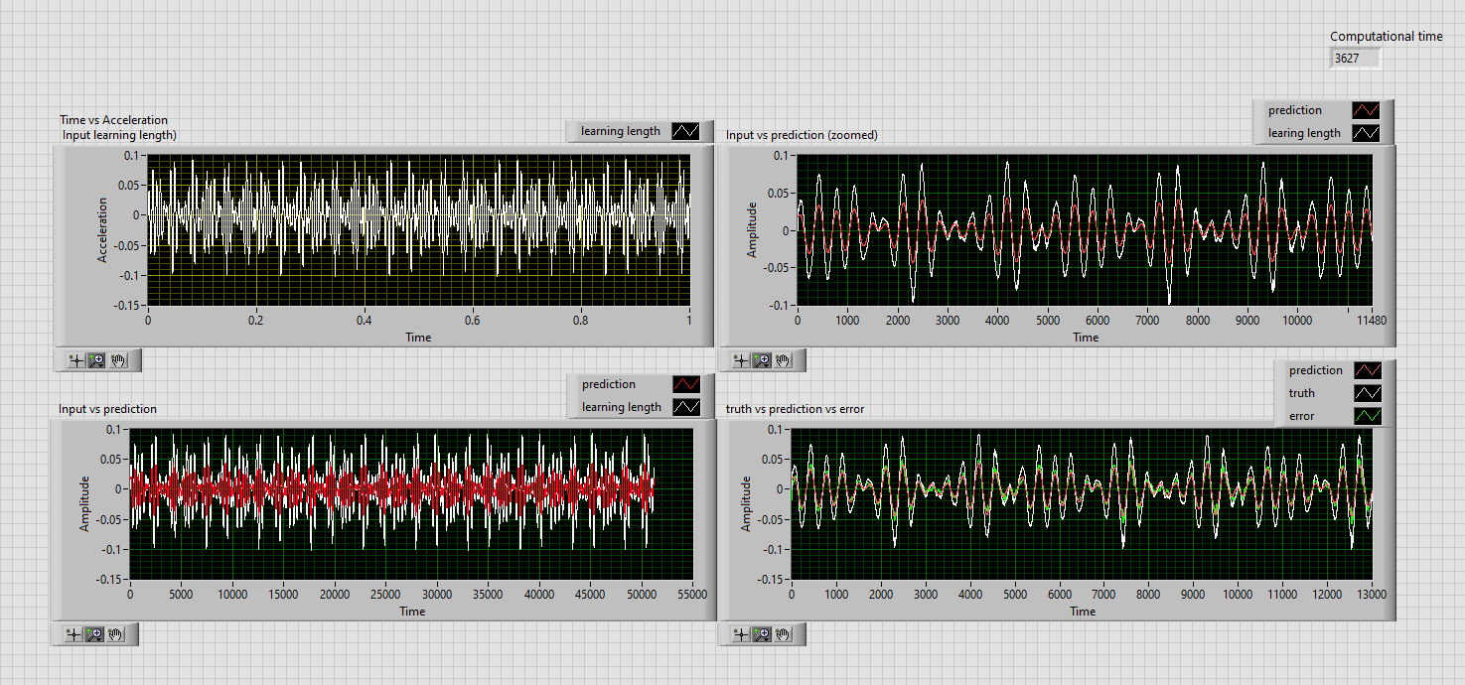
Labview implimentation

Slide 4
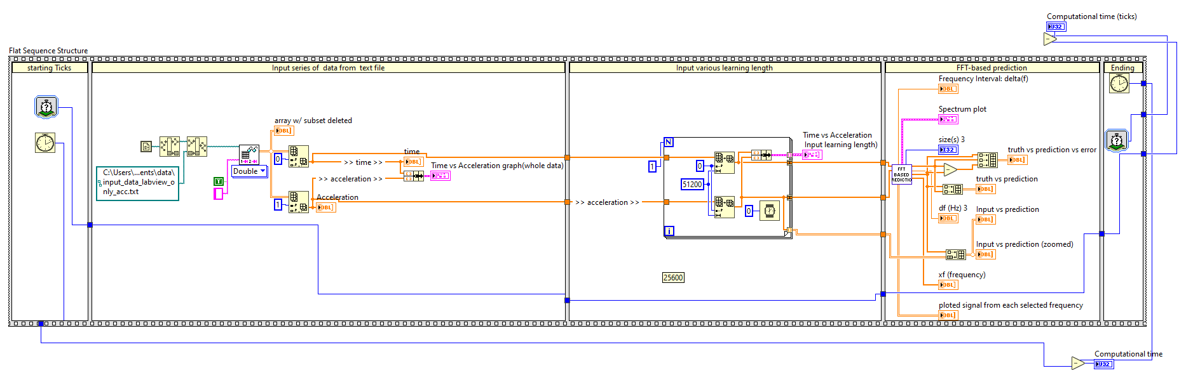
Labview code

Slide 5
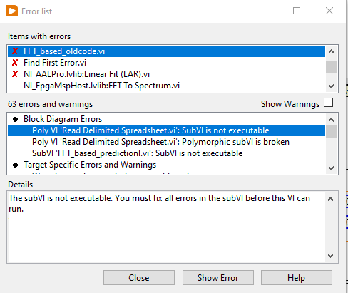
Labview code transfer to FPGA labVIEW

Slide 6
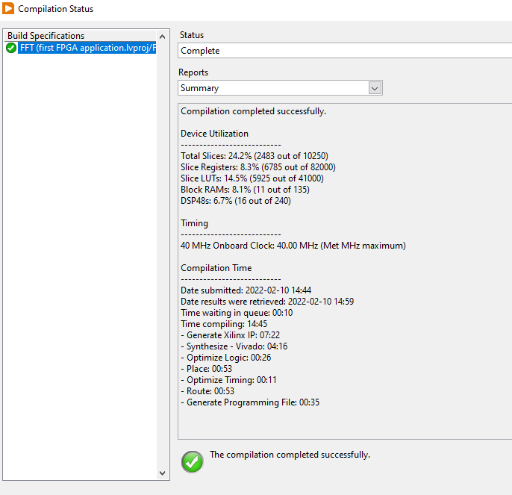
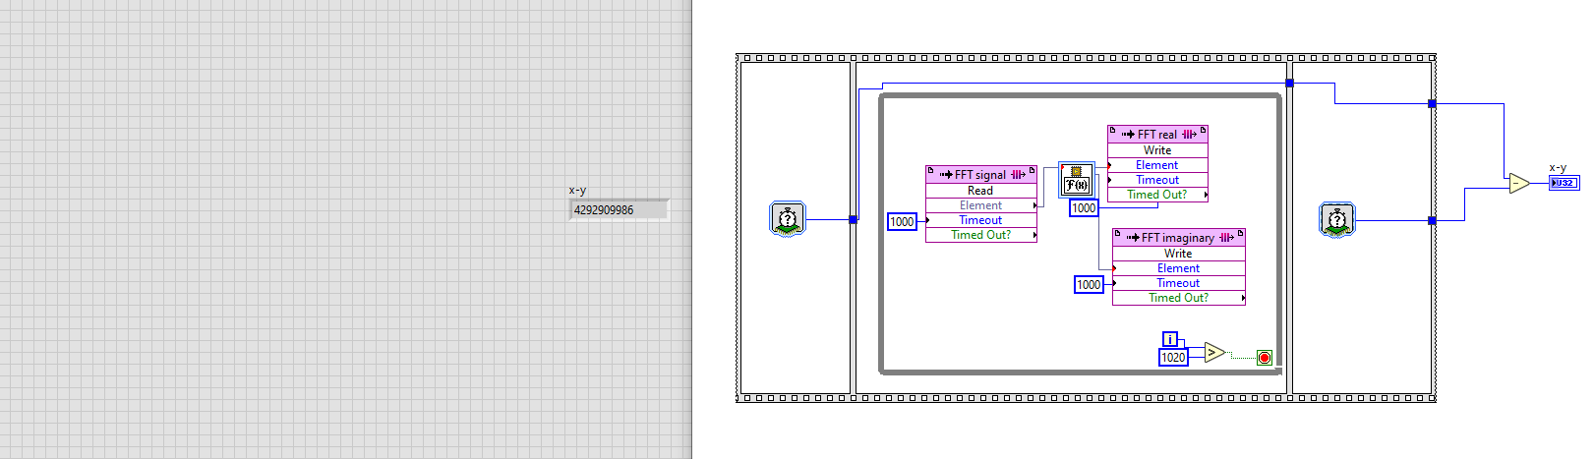
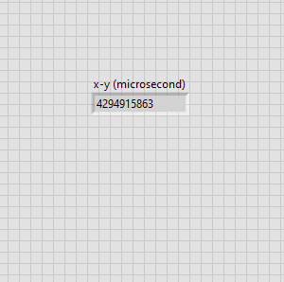
Start from beginning
Build in FPGA (like target)
Simple FFT
Compile

Slide 7
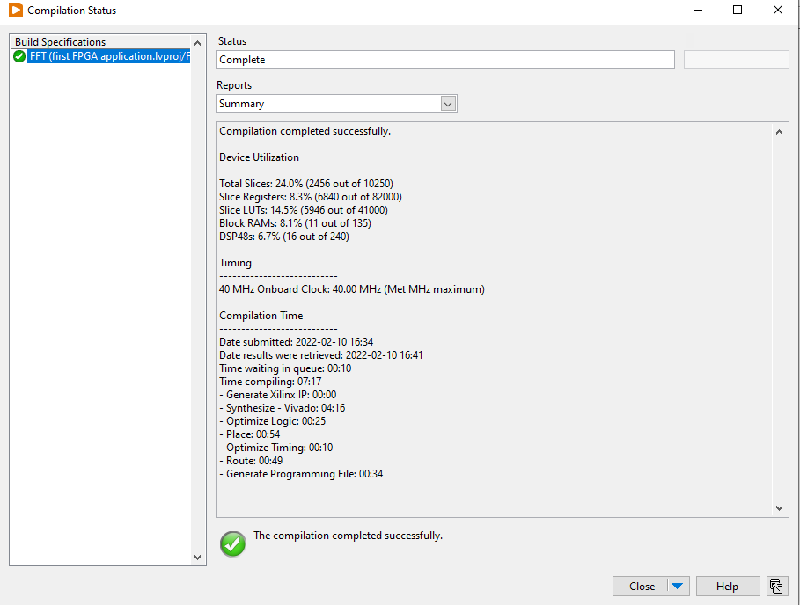
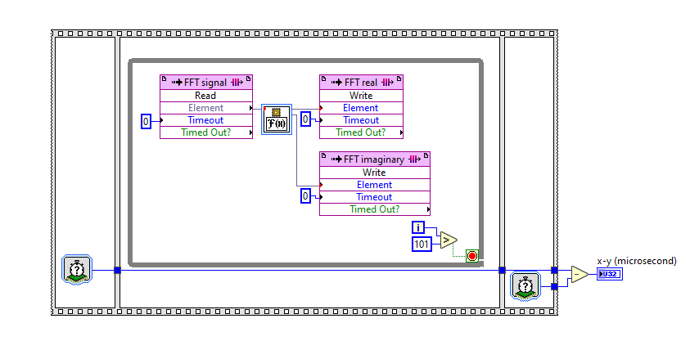
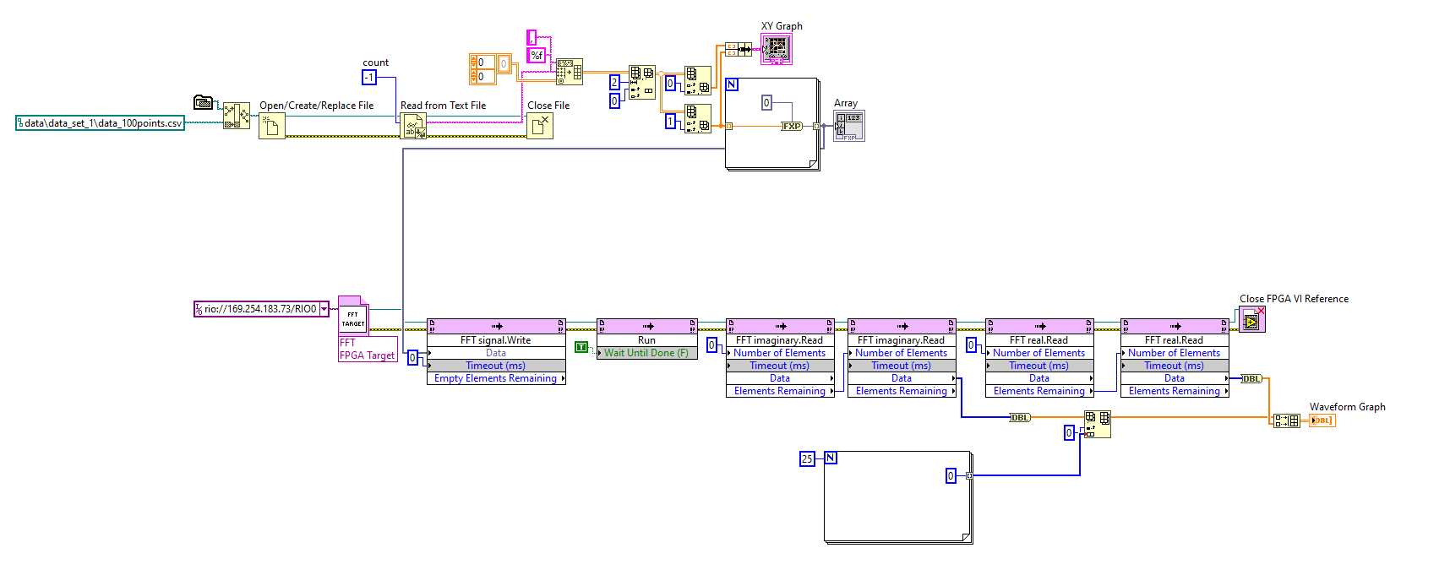
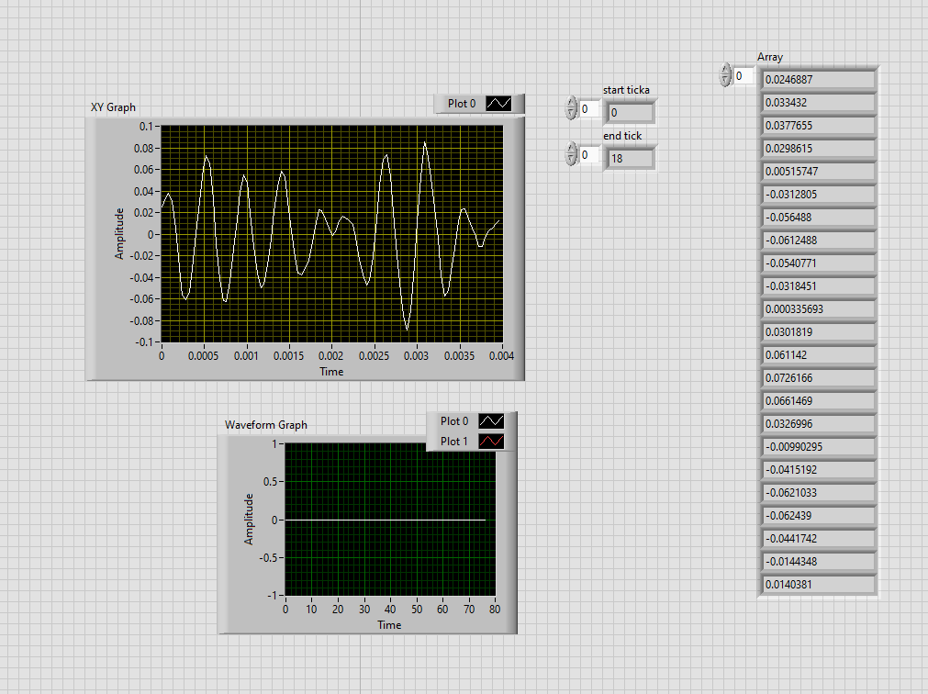
Start from beginning
Build in FPGA (like target)
Simple FFT
Data send from host
Compile

Slide 8
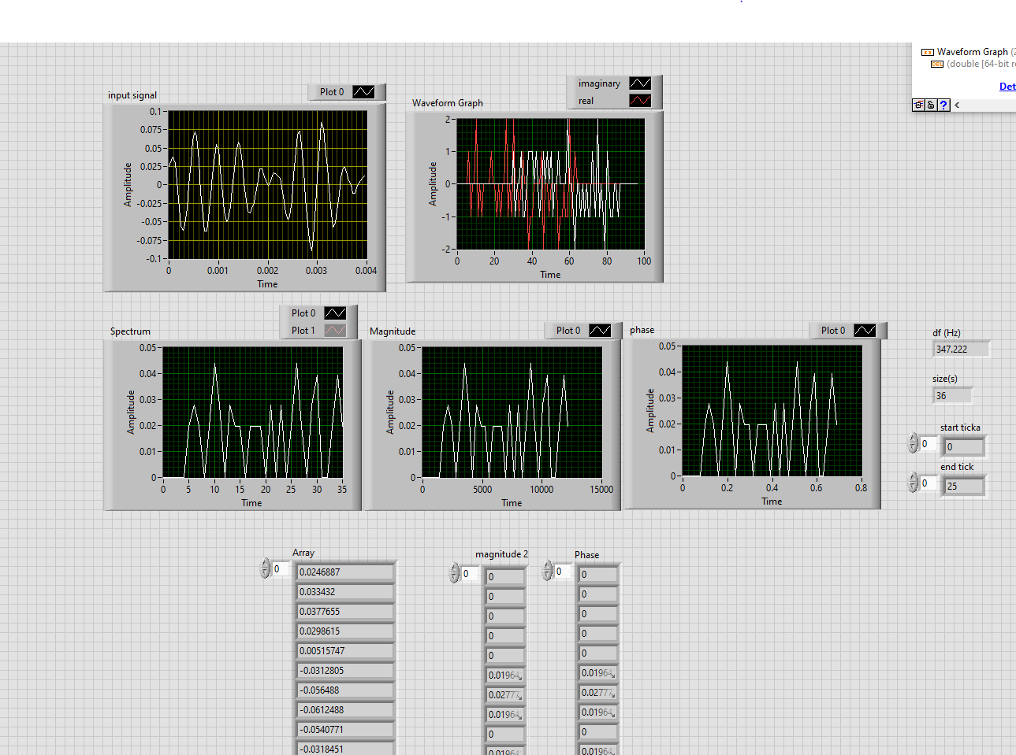
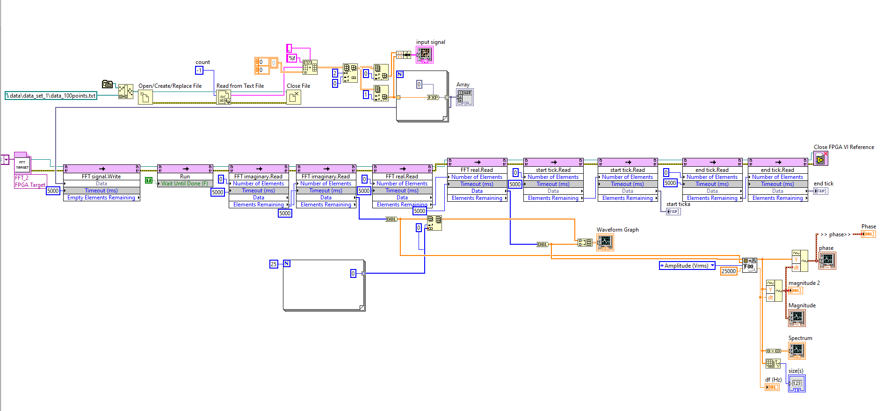
FPGA
Data send from host
Compile
FFT to real and imaginary in Target
Using real and imaginary from host and get spectrum , magnitude and phase ( is not correct)
Data (25000 S/sec) (used for MLP,100 points)

Slide 9
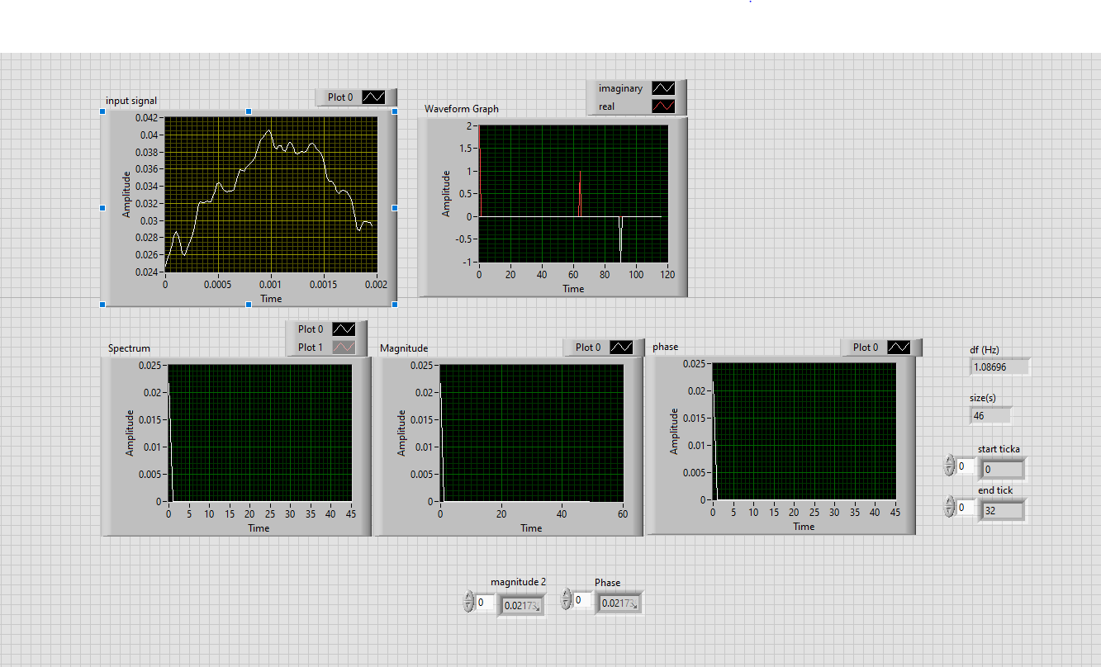
FPGA
Data send from host
Compile
FFT to real and imaginary in Target
Using real and imaginary from host and get spectrum , magnitude and phase ( is not correct)
Data (51200 S/sec) (only 100 points)

Slide 10
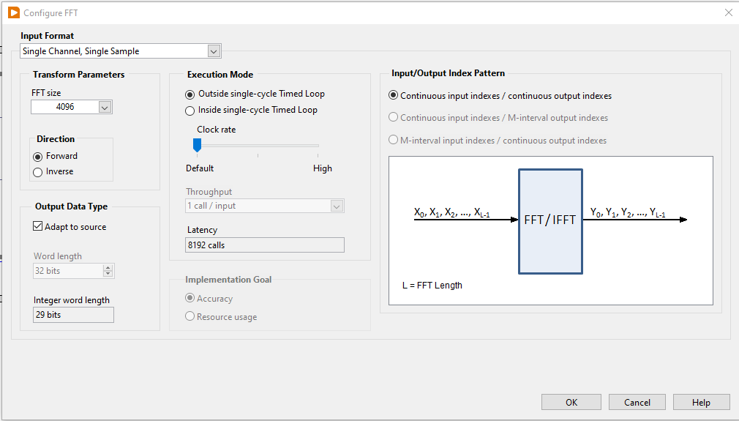
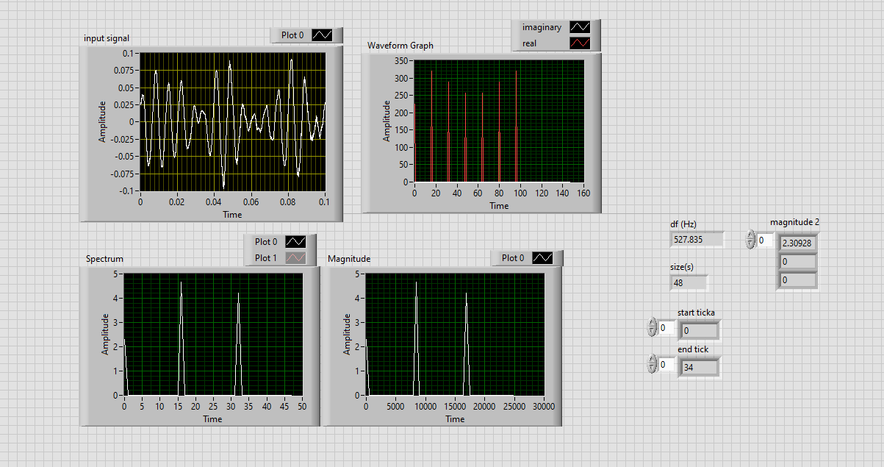
FPGA
Data send from host
Compile
FFT to real and imaginary in Target
Using real and imaginary from host and get spectrum , magnitude and phase ( is not correct)
Data (51200 S/sec) (only 100 points)
FFT size in target(FFT.vi) is 4096

Slide 11
Thanks!

